Slide 1


Credit Risk Assessment for GE Using CRISP-DM
Welcome to our comprehensive guide on implementing a data mining project using the CRISP-DM methodology. This presentation will walk you through each phase, from business understanding to deployment.
By Solar Shrestha

Slide 2
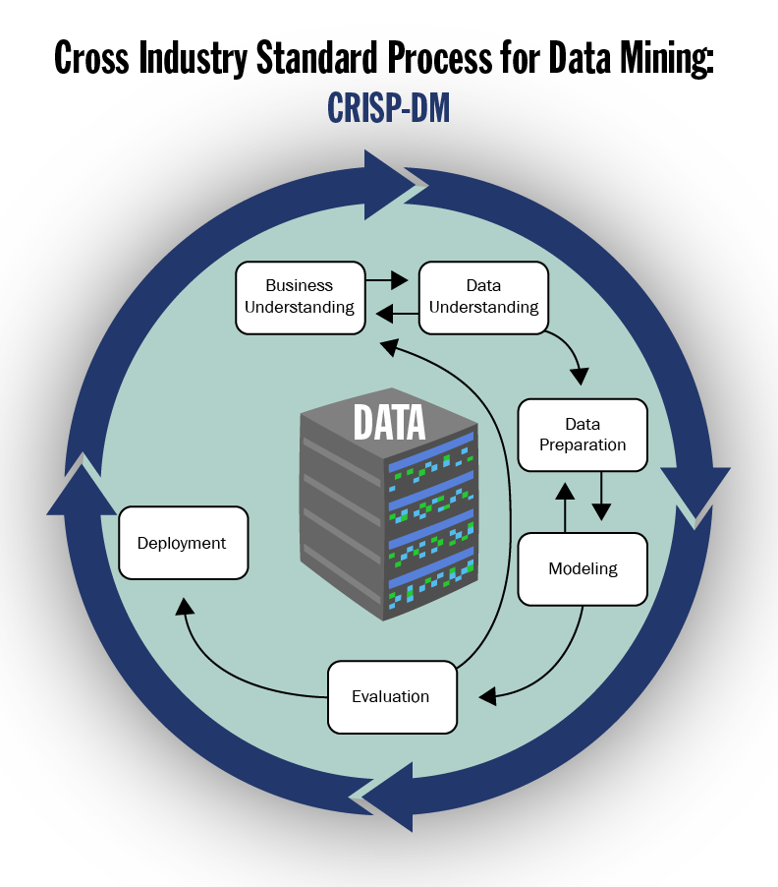
CRISP-DM Overview
1
Business Understanding
Define objectives and problem statement
2
Data Understanding
Explore and verify data
3
Data Preparation
Create analytic architecture
4
Modeling
Apply data mining techniques
5
Evaluation
Assess model performance
6
Deployment
Image Source: https://learn.snhu.edu/d2l/le/content/1739062/viewContent/36029637/View
Implement solution in business context
Notes:
GE is facing unpredictable revenue loss due to issues arising from defaulted borrowers. The loan application has been overlooked because a proper system needs to be in place, and applicants who are likely to default are provided with the loan amount. This has resulted in revenue loss and a rise in collection attempts on default loans.
Why I Selected This Problem:
Relevance to My Interests: With experience in the banking industry and exposure to loan approval processes, I have developed a strong interest in leveraging data analytics to improve financial decision-making. This problem presents an opportunity to apply advanced analytical techniques to identify high-risk applicants, reduce default rates, and enhance operational efficiency.
Impact on Business Operations: A robust credit risk assessment system will allow GE to predict borrower defaults proactively. By refining the loan approval process, GE can minimize defaults, reduce collection costs, and improve financial stability.
Application of Predictive Analytics: Using data mining models (e.g., logistic regression, decision trees, or machine learning algorithms), GE can predict the probability of loan defaults based on key factors such as credit score, income level, debt-to-income ratio, and loan amount. These insights will drive better decision-making for loan approvals.
Data Availability and Feasibility:
GE possesses abundant historical and real-time data, which will form the foundation for this project:
Loan Application Data:
Borrowed amount, applicant income, loan term, and interest rates.
Client Credit Information:
Credit scores, current debt obligations, and payment history.
Default Loan Records:
Historical data on default rates, borrower profiles, and recovery efforts.
With this data, we can implement a CRISP-DM approach:
Business Understanding: Align project objectives to reduce default risks.
Data Understanding: Explore available data to identify any missing or inconsistent information.
Data Preparation: Clean and preprocess the data for modeling purposes.
Modeling: Apply predictive algorithms to classify loan applicants as either high-risk or low-risk.
Evaluation: Assess the model's accuracy using key performance metrics (AUC, precision, recall).
Deployment: Integrate the model into the loan approval system to enable real-time, data-driven decisions.

Slide 3

Business Understanding Phase
Problem Statement
Business Objectives
Clearly define the business problem to be solved.
Identify specific, measurable goals for the project.
Industry Context
Data Mining Goals
Understand the organization's position and challenges in the industry.
Translate business objectives into data mining goals.
Notes:
We are implementing a Cross-Industry Standard Process for Data Mining (CRISP-DM) for proper execution.
The business understanding phase relates to the credit analyst using the predictive model derived from the given variables to assess the risk associated with the new applications.
Problem Statement: Clearly define the business problem, such as identifying high-risk customers to reduce loan defaults and improve financial stability through advanced credit risk assessment techniques.
Business Objectives: Establish measurable goals, like decreasing credit default rates by 15% over the next year or improving the accuracy of risk classification models by 10%.
Industry Context: Analyze market challenges, such as fluctuating economic conditions, changes in regulatory requirements, and competitors’ credit risk management strategies to position GE effectively in the financial sector.
Data Mining Goals: Transform business objectives into actionable data goals, such as developing predictive models (e.g., logistic regression, decision trees) to identify credit risk and using customer financial data for detailed risk scoring.
Alignment: Ensure that all stakeholders understand how this assessment improves risk management, aligns with compliance, and enhances operational efficiency to drive business value for GE.

Slide 4
Data Understanding Phase
Describe Data
Explore Data
Verify Data
Identify data sources and types. Document data characteristics and formats.
Perform initial data analysis. Use descriptive statistics to understand data distribution.
Check data quality and completeness. Identify potential issues or biases.
Notes:
Data Understanding:
This phase involves understanding the correlation between credit amount, employment, and account status variables. During this phase, we must also assess missing data, inconsistencies, or outliers. By describing data and verifying data quality, we can generate a reliable predictive model for risk assessment.
Describe Data: GE begins the credit decision-making process by identifying data sources, such as loan application records, applicant financial details, credit scores, and historical default data, ensuring all data formats are well-documented.
Explore Data: Initial analysis uses descriptive statistics to understand key variables, such as income levels, loan amounts, debt-to-income ratios, and credit scores, enabling insights into data trends and distributions.
Verify Data: Data quality checks ensure that no records are missing, incomplete, or inconsistent and identify potential biases, such as underrepresented applicant groups or skewed default patterns.
Data Insights: By exploring and verifying the data, GE can uncover patterns that predict loan defaults, helping differentiate high-risk applicants from low-risk borrowers.
Informed Decisions: This phase provides the foundation for developing a robust credit scoring model that supports GE in making data-driven loan approvals, reducing defaults, and ensuring financial stability.
Tools to Use:
R will be used to analyze data and develop a predictive model. Caret in R is a valuable tool for predictive analysis.
For data visualization, Tableau will create insights and dashboards for the stakeholders to understand better.
Challenges:
Data quality, preparation, model accuracy, and scalability are a few anticipated challenges. Data quality is crucial for data analytics and will be my biggest challenge. Achieving a high level of accuracy with predictive modeling and its ability to adapt to the existing system could also be challenging.

Slide 5
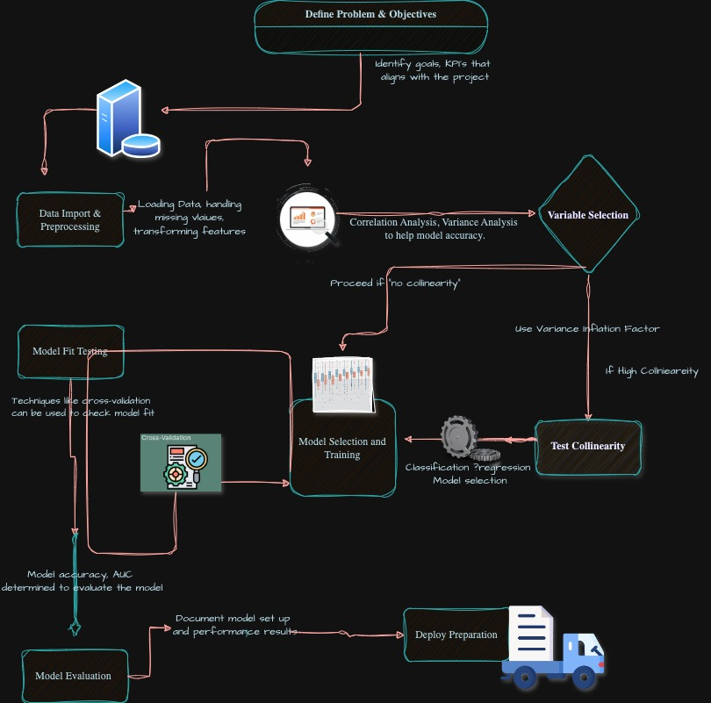




Data Preparation: Analytic Architecture
Data Collection
Gather data from various sources
Data Integration
Combine data into a unified format
Data Cleaning
Address missing values and outliers
Feature Engineering
Create new variables to improve model performance
Notes:
Data Preparation:
This is typically the most time-consuming phase. During this phase, the available data is cleansed by handling missing data values, normalizing continuous variables, and encoding categorical variables. If needed, data construction, formatting, or integration will also occur. For example, the data set will be divided into training and testing sets to amplify the model’s performance.
Notes on the Flowchart:
Define Problem & Objectives:
The process begins by clearly defining the problem and identifying key performance indicators (KPIs) to align the project goals with business objectives.
Data Import & Preprocessing:
The data is loaded, and preprocessing tasks, such as handling missing values, transforming features, and ensuring data quality, are performed to prepare it for analysis.
Variable Selection:
Variables are analyzed using correlation and variance analysis to determine their importance for the model. This step aims to enhance model accuracy by focusing on relevant features.
Testing for Collinearity:
If high collinearity exists between variables, techniques like the Variance Inflation Factor (VIF) identify and address redundancy, ensuring robust model performance.
Model Selection & Training:
Based on the problem type (classification or regression), appropriate machine learning models are selected and trained using the processed data.
Model Fit Testing:
Cross-validation techniques are employed to assess how well the model generalizes to unseen data, ensuring its reliability for deployment.
Model Evaluation:
The model's performance is evaluated by key metrics such as accuracy and the Area Under the Curve (AUC). The setup and results are documented for transparency.
Deploy Preparation:
Once validated, the model is prepared for deployment, ensuring it is ready for real-world applications and aligns with project objectives.

Slide 6

Data Quality and Integrity
Accuracy
Completeness
Ensure data correctness and precision
Address missing or incomplete data points
Consistency
Timeliness
Maintain uniform data formats across sources
Use up-to-date and relevant data
Notes:
Accuracy:
GE must ensure the correctness and precision of loan applicant data, such as income details, credit scores, and debt-to-income ratios, to improve the reliability of credit decision-making.
Completeness:
Addressing missing or incomplete data points in loan applications, such as undocumented financial information or missing credit history, will help GE make informed and confident decisions about borrower risk.
Consistency:
Maintaining uniform data formats across all sources, such as standardized reporting for credit scores and financial metrics, ensures seamless integration and analysis during the credit evaluation process.
Timeliness:
GE must use up-to-date and relevant data, such as recent payment histories and real-time credit updates, to accurately assess borrowers' financial health and creditworthiness.
Data Integrity:
By prioritizing data quality and integrity, GE can confidently implement predictive models that minimize loan defaults, optimize credit approvals, and reduce financial risks.

Slide 7





Data Protection Strategies
Encryption
Access Control
Protect sensitive data during storage and transmission
Implement role-based access to data resources
Anonymization
Data Retention
Remove personally identifiable information from datasets
Establish policies for data storage and deletion
Notes:
Encryption: GE should implement encryption to secure sensitive customer information, including credit scores, income details, and loan amounts, during both storage and transmission to prevent unauthorized access. Additionally, GE must ensure compliance with data protection laws such as GDPR, CCPA, and HIPAA.
Access Control: Role-based access control ensures that only authorized personnel, such as credit analysts and decision-makers, can access critical credit evaluation data, thereby preserving the integrity of the credit decision-making process.
Anonymization: GE can anonymize personally identifiable information (PII) within datasets to adhere to privacy regulations while still allowing for data-driven insights related to risk assessment and credit approvals. This process will effectively remove PII from datasets to safeguard user privacy, address ethical concerns such as bias in data analytics, and ensure fairness and transparency.
Data Retention: Establishing clear policies for data storage and deletion guarantees that GE retains only relevant historical credit data, which helps reduce storage costs and mitigates the risks associated with outdated or irrelevant information impacting decisions.
Data Protection Framework: By integrating encryption, access control, and anonymization, GE can ensure the confidentiality, integrity, and availability of credit-related data, fostering trust and enabling accurate and secure decision-making. It is important to consider broader societal and ethical issues, including algorithmic bias, fairness in decision-making, and the responsible use of data.

Slide 8




Stakeholder Visualization Needs
Executives
1
High-level KPI dashboards
Managers
2
Department-specific performance metrics
Analysts
3
Detailed data exploration tools
Operational Staff
4
Real-time operational metrics
Notes:
Value for Less Technical-Oriented Stakeholders
It is essential to simplify complex data into actionable insights for non-technical stakeholders to see the value. The easiest way to achieve this is by using interactive and dynamic visualizations, like dashboards and infographics, which will present data patterns, trends, and predictions more engagingly as they visualize them. Non-technical stakeholders can interact with the visualization, including the dashboard, which fosters engagement (Few, 2012). Simplifying the technical data into non-technical terminology can also enhance engagement while keeping it relevant.
Tailoring Presentations for IT, Peers, and Management
Communicating appropriately with different departments with varied approaches is crucial for better communication and value.
IT Department: Since the IT department is more technically inclined, this audience may find value in the technical methodologies used, such as the data sources, how they were refined, and the algorithms used. Data scalability and integration play vital roles for the IT department.
Peers: The fellow data analyst may appreciate the deeper dives into the models used and data validation techniques implemented. Ensuring that the outcomes are reproducible and reliable and fostering trust and collaboration is essential.
Management: Upper management and executives like to see the summary and how the presentation is going to save cost and mitigate if or any risk involved. It will be crucial to give them a high-level summary using key performance indicators (KPIs) and ROI (Return on Investment) and demonstrating how it aligns with the business objective (Dykes, 2016).
Application to the Data Analytic Presentation:
Implementing an interactive dashboard will allow me to engage stakeholders in real time for my upcoming presentation. The dashboard's drill-down methods will help management explore independently. I will design a tailored visualization for each audience to ensure the alignment of their interest. For peers, I will outline the data preparation and model validation process. For the IT department, I will briefly explain data pipelines and the technologies used.
Executives: GE executives require high-level KPI dashboards to monitor overall credit risk performance, including metrics like default rates, total approved loans, and revenue impact to support strategic decision-making.
Managers: Managers focus on department-specific performance metrics, such as loan approval efficiency, collection success rates, and borrower segmentation, to optimize team operations and reduce default risks.
Analysts: Analysts need detailed data exploration tools to analyze borrower data, identify trends, and evaluate predictive model outputs for improving credit risk assessments.
Operational Staff: Real-time operational metrics allow loan officers and collection teams to monitor loan statuses, track repayment behaviors, and take immediate action on overdue or defaulting loans.
Integrated Visualization: Providing tailored visualizations for each stakeholder ensures that GE improves decision-making across all levels, from strategic planning to day-to-day credit risk management.

Slide 9



Leveraging Industry Knowledge for Data-Driven Success
1
Apply Contextual Knowledge
2
Target New Data Opportunities
3
Improve Organizational Outcomes
Harness deep industry insights to identify untapped data sources. Transform raw information into actionable intelligence for your organization.
Enhance Competitiveness
Boost Effectiveness
Ensure Longevity
Streamline operations and decision-making with data-driven insights.
Future-proof your organization through adaptive data strategies.
Gain a strategic edge by leveraging unique industry data.
Notes:
Leveraging contextual knowledge enables GE to make informed decisions, transforming data into actionable intelligence to enhance competitiveness in the market. For instance, historical sales data can help GE forecast demand and optimize inventory.
GE can uncover untapped insights through AI-driven analytics and IoT technology by targeting new data opportunities, strengthening its strategic advantage in emerging markets, and identifying real-time operational trends.
Improving organizational outcomes necessitates harnessing industry-specific data to streamline operations and enhance decision-making efficiency. This can be measured by reduced operational costs, quicker decision-making processes, or improved productivity.
Data-driven insights can enhance effectiveness by integrating workflow automation systems and real-time dashboards, allowing GE to optimize workflows and allocate resources more efficiently.
Ensuring longevity through adaptive data strategies future-proofs GE by implementing scalable solutions such as cloud-based infrastructures and predictive analytics, enabling them to remain resilient amidst evolving market trends and disruptions.

Slide 10
Deployment Plan
Solution Testing
1
Validate model performance in controlled environment
Pilot Implementation
2
Deploy solution to limited user group
Full Rollout
3
Expand solution to entire organization
User Training
4
Provide comprehensive training to end-users
Notes:
The Deployment Plan illustrated in the attachment highlights four key stages: Solution Testing, Pilot Implementation, Full Rollout, and User Training. Together, these stages enable the successful adaptation and implementation of innovative methods, models, and technologies to improve agility in data analytics projects.
Solution Testing: By validating model performance in a controlled environment, GE ensures that the deployed solutions are robust, adaptable, and ready to handle unexpected changes in data or operational requirements. This stage leverages innovative testing methodologies, such as simulation or stress testing, to assess model agility.
Pilot Implementation: Deploying the solution to a limited user group allows for real-world evaluation, ensuring any issues or unpredicted changes can be identified and addressed. This step uses an iterative approach to refine the solution based on user feedback and performance metrics.
Full Rollout: Expanding the solution across the entire organization ensures scalability and adaptability. To support flexible and agile implementation at scale, technologies like cloud-based tools and containerized deployments (e.g., Docker, and Kubernetes) can be integrated.
User Training: Comprehensive training equips end-users with the knowledge to adapt effectively to new systems and tools. It also enhances user readiness to respond to changing data trends or operational workflows.
By following this deployment plan, GE can continuously adapt its data analytics models to evolving business needs, ensuring agility and responsiveness in handling new and unexpected challenges.

Slide 11

Project Impact and Conclusions
25%
$1M
Efficiency Increase
Cost Savings
Streamlined processes led to significant time savings
Reduced operational costs through data-driven decision making
95%
3x
User Satisfaction
ROI
High adoption rate and positive feedback from stakeholders
Project delivered substantial return on investment
Notes:
Positioning Data Analytics as a Competitive Advantage
Tangible Benefits: Measurable outcomes, such as a 25% increase in efficiency, significant time savings, and streamlined operations. This demonstrates how data analytics can optimize processes and reduce operational bottlenecks.
Cost Savings as a Driver: impact of analytics on cost reductions, such as the $1M saved in operational expenses through data-driven decision-making. These savings illustrate the immediate return on investment and financial value to stakeholders.
Long-Term ROI: substantial financial returns, like a 3x ROI, which emphasizes how strategic analytics implementation addresses immediate challenges and ensures sustainable growth and profitability over time.
Enhanced Stakeholder Satisfaction: A 95% user satisfaction adoption rate indicates the capacity of data-driven technologies to boost user engagement, improve decision-making accuracy, and foster trust across teams.
Strategic Decision-Making: Position data analytics as a tool for future-proofing the organization. By emphasizing efficiency, cost savings, and improved performance, organizations can remain competitive, agile, and better equipped to make informed decisions in a rapidly evolving market.

Slide 12


Questions and Feedback Session

Slide 13
Reference
Batini, C., Cappiello, C., Francalanci, C., & Maurino, A. (2009). Methodologies for data quality assessment and improvement. ACM Computing Surveys (CSUR), 41(3), 1-52. https://doi.org/10.1145/1459352.1459353
Chen, D., & Zhao, H. (2012). Data security and privacy protection issues in cloud computing. International Conference on Computer Science and Electronics Engineering, 647-651. https://doi.org/10.1109/ICCSEE.2012.193
NIST. (2020). Guide to protecting the confidentiality of personally identifiable information (PII): Special Publication 800-122. National Institute of Standards and Technology. https://doi.org/10.6028/NIST.SP.800-122
Olson, J. E. (2003). Data quality: The accuracy dimension. Morgan Kaufmann.
Stallings, W. (2017). Cryptography and network security: Principles and practice (7th ed.). Pearson.
Tankard, C. (2012). Big data security. Network Security, 2012(7), 5-8. https://doi.org/10.1016/S1353-4858(12)70063-6
Wang, R. Y., Storey, V. C., & Firth, C. P. (1995). A framework for analysis of data quality research. IEEE Transactions on Knowledge and Data Engineering, 7(4), 623-640. https://doi.org/10.1109/69.404034
Zaslavsky, A., Perera, C., & Georgakopoulos, D. (2012). Sensing as a service and big data. International Conference on Advances in Cloud Computing (ACC), 21-29.
Few, S. (2013). Information dashboard design: Displaying data for at-a-glance monitoring (2nd ed.). Analytics Press.
Tableau Software. (2020). Visual analysis best practices: Simple techniques for making every dashboard more impactful. Tableau Software. Retrieved from https://www.tableau.com
Marr, B. (2018). Data-driven decision making: 10 simple steps for business success. Forbes. Retrieved from https://www.forbes.com/sites/bernardmarr/2018/01/29/data-driven-decision-making-10-simple-steps-for-business-success/
Kaplan, R. S., & Norton, D. P. (1996). The balanced scorecard: Translating strategy into action. Harvard Business Press.
Wang, J., & Strong, D. M. (1996). Beyond accuracy: What data quality means to data consumers. Journal of Management Information Systems, 12(4), 5-33. https://doi.org/10.1080/07421222.1996.11518099
Stallings, W. (2017). Cryptography and network security: Principles and practice (7th ed.). Pearson.
NIST. (2020). Guide to protecting the confidentiality of personally identifiable information (PII): Special Publication 800-122. National Institute of Standards and Technology. https://doi.org/10.6028/NIST.SP.800-122
Chen, D., & Zhao, H. (2012). Data security and privacy protection issues in cloud computing. International Conference on Computer Science and Electronics Engineering, 647-651. https://doi.org/10.1109/ICCSEE.2012.193
Tankard, C. (2012). Big data security. Network Security, 2012(7), 5-8. https://doi.org/10.1016/S1353-4858(12)70063-6
Zaslavsky, A., Perera, C., & Georgakopoulos, D. (2012). Sensing as a service and big data. International Conference on Advances in Cloud Computing (ACC), 21-29.
Few, S. (2013). Information dashboard design: Displaying data for at-a-glance monitoring (2nd ed.). Analytics Press.
Tableau Software. (2020). Visual analysis best practices: Simple techniques for making every dashboard more impactful. Tableau Software. Retrieved from https://www.tableau.com
Marr, B. (2018). Data-driven decision making: 10 simple steps for business success. Forbes. Retrieved from https://www.forbes.com/sites/bernardmarr/2018/01/29/data-driven-decision-making-10-simple-steps-for-business-success/
Kaplan, R. S., & Norton, D. P. (1996). The balanced scorecard: Translating strategy into action. Harvard Business Press.
Wang, J., & Strong, D. M. (1996). Beyond accuracy: What data quality means to data consumers. Journal of Management Information Systems, 12(4), 5-33. https://doi.org/10.1080/07421222.1996.11518099
Beck, K., Beedle, M., Van Bennekum, A., Cockburn, A., Cunningham, W., Fowler, M., ... & Thomas, D. (2001). Manifesto for agile software development. Agile Alliance. Retrieved from https://agilemanifesto.org/
Kim, G., Humble, J., Debois, P., & Willis, J. (2016). The DevOps handbook: How to create world-class agility, reliability, & security in technology organizations. IT Revolution Press.
Fowler, M., & Highsmith, J. (2001). The agile manifesto. Software Development, 9(8), 28-35.
Gandomi, A., & Haider, M. (2015). Beyond the hype: Big data concepts, methods, and analytics. International Journal of Information Management, 35(2), 137-144. https://doi.org/10.1016/j.ijinfomgt.2014.10.007
Erich, F., Amrit, C., & Daneva, M. (2017). A qualitative study of DevOps usage in practice. Journal of Software: Evolution and Process, 29(6), e1885. https://doi.org/10.1002/smr.1885
Kwon, O., Lee, N., & Shin, B. (2014). Data quality management, data usage experience and acquisition intention of big data analytics. International Journal of Information Management, 34(3), 387-394. https://doi.org/10.1016/j.ijinfomgt.2014.02.002

